Slide 1
MapR Data Platform
The Most Advanced AI and Analytics Dataware
Technical Workshop

Slide 2
Agenda
Introduction / objectifs
Les origines : pourquoi MapR ?
MapR Data Platform Overview
Démo
Fondations : MapR-FS
MapR-DB et MapR-Streams
A la carte

Slide 3
Les Origines

Slide 4




« Data is the next BIG thing »

Slide 5



Slide 6

DATA TECHNOLOGIES
Deliver Industry’s best data platform for present and future use cases
Decouple data from applications and infrastructure
Provide enterprise grade capabilities and unrivalled performances

Slide 7















MapR Company At A Glance
Founded
2009
Santa Clara, CA
700+ people
13 offices
1000+ Customers – All Verticals
100%+
Revenue Growth

Slide 8








Community Participant, Contributor, Leader
MapR actively contributes
Bug fixes
Improvements
MapR leads projects
Apache Drill
Apache Myriad
MapR supports the community
Free Code Fridays
High quality free on-demand training
Sponsorships, Meet-ups, and more
Arrow

Slide 9



MapR Data Platform Evolves With Your Needs
VISION: A POWERFUL INNOVATIVE DATAWARE
Execute wide range of analytical and AI tools
EXCEPTIONAL MISSION CRITICAL CAPABILITIES
High scale, high reliability, efficient architecture
Data protection and disaster recovery features
Distributed technology platform
Built-in consistent platform wide security
INFRASTRUCTURE AGNOSTIC
Data and app movement from on-prem to in-cloud
Stateful apps with containerization
PROVEN VALUE AT PRODUCTION SCALE
Large global enterprises rely on MapR
Financial Services, Telcom, Healthcare, Retail and more
ENTERPRISE HADOOP WORKLOADS
SPARK AND STREAM
ANALYTICS
AI AND ML
MAPR DATA PLATFORM
CENTRAL CLOUD MULTI-CLOUD EDGE KUBERNETES
2009
2018

Slide 10





MapR Data Platform
Existing Enterprise Applications
Interactive / Self Service BI Big Data Processing
Modern Applications
Machine Learning
Open Access APIs
POSIX, NFS, HDFS, S3, REST, JSON, HBASE, SQL, KAFKA
DATA SERVICES
Files
Operational Database
Event Data Streams
SECURITY & ACCESS CONTROLS
PLATFORM MONITORING & CONFIGURATION
PLATFORM SERVICES
DATA ACCESS SERVICES
DATA PROTECTION SERVICES
DATA AVAILABILITY SERVICES
STORAGE SERVICES

Slide 11
Business and Innovation Benefits of the MapR Data Platform
BUSINESS BENEFITS
INNOVATION BENEFITS
Innovate & Reduce TCO by sharing a common data infrastructure across data users and workloads.
Use less resources with a unified security and administrative environment.
SLAs on open source by providing business critical SLAs on latest open source tooling.
Data control giving you all controls on your key digital asset – data.
Focus on new applications instead of managing and running data infrastructure.
Leverage any cloud services: hybrid, public, and/or private.
Reduce development time of new applications while maintaining security controls.
Reduce time and effort in leveraging latest emerging technologies.

Slide 12
Demo

Slide 13
Les fondations : MapR File System

Slide 14
Cahier des charges
100% compatible avec l’écosystème Hadoop, mais sans les limitations de HDFS
Scalable horizontalement sans limites : pas de name node
Multi-usage : Hadoop, mais pas que → read/write, small blocks
Performant : C / C++
Résilient : backup et disaster recovery intégré

Slide 15
High level design
Mount point :
/mapr/myCluster/myVolume
myVolume
Volumes
Containers
Nodes

Slide 16


Logical architecture
Mount point :
/mapr/myCluster/myVolume
myVolume
Volumes
Files
Chunks
256MB
Blocks
8KB

Slide 17




Storage architecture
Nodes
Storage Pools
Containers
Drives

Slide 18


MapR is Architected for Scalability and Speed
Classic HDFS MapR-FS
NameNode
Centralized Metadata
CLDB
Tracks Container Locations
MapR-FS Design Benefits:
High Parallelism
Extreme Scalability
Extreme Throughput
Simpler Multitenancy
Containers
Up to 32GB (Self-adjusting)
Blocks
128MB Default (Configurable at setup)
Chunks
256MB (Adjustable per directory)
8KB
Blocks
8KB (Fixed)
HDFS’s NameNode is a single process containing an in-memory table which stores all file metadata and the locations of all Blocks in the filesystem. The 128MB Block size was selected for batch programs.
Scalability = (# Blocks x Block Size)
The CLDB stores the locations of Containers. Containers are replicated data structures which live in Storage Pools. Containers hold File Chunks and Directories and the locations of File Chunks. This architecture has an extra step of indirection, but it introduces scale and parallelism. Containers are infrequently created/moved, so the CLDB is relatively stable. Containers are also relatively large (and therefore, relatively few), so the CLDB is relatively small. The CLDB’s data is stored in a Container and is replicated, so it is highly available.
Scalability = (# Containers x Container Size)
Detailed video at: http://bit.ly/2j2j8wx

Slide 19
MapR and HDFS – Other Similarities and Differences
Similarities:
Implement HDFS API
Distributed File System
Automatic Replication of Data
Commodity Servers
Local Disks
POSIX Client
NFS Gateway
NFS Gateway
3
Security
Compression
Parallelism
MapR
1
HDFS
2
JVM
Linux FS
Differences:
MapR-FS: Fully Read/Write
MapR-FS: No Java, No JVM
MapR-FS: No Linux File System
MapR-FS: Direct NFS Writes
MapR-FS: POSIX client
File:
File:
Fully Read/Write
Direct Disk I/O
Real-time NFS access
Write Once, Append
Needs JVM and Linux FS
Byte-ordering issues with NFS
Detailed video at: http://bit.ly/2Af4A8A

Slide 20
MapR Volumes

Slide 21

Volumes
Volumes are Logical Structures for Holding and Managing All Types of Data
Standard Volume
Volumes apply policies to many items all at once, instead of file-by-file.
Volumes can be nested like sub-directories.
Volumes can enforce disk usage limits
Volumes establish ownership and accountability, and more
Volumes can set data replication levels

Slide 22


Access Control with Volumes
/apps
BENEFITS OF VOLUMES & ACEs
Universal pathnames
Volume ACEs
Separation of powers
Invisible control
/raw
/archive
/training
/web
/pos
/et
/mkt
/fraud
ACE here
/P1
/P2
/P3
web
pos
Clean
Files
Tables
Streams
et
Arrange & Extract
training
= Volume
Detailed video at https://mapr.com/blog/access-control-with-volumes/

Slide 23
Volume Snapshots
A Snapshot is a Consistent, Point-in-Time view of a Volume
Standard Volume
Snapshots are almost instantaneous
Snapshots consume almost no space
Snapshots can be scheduled or on-demand
Snapshots help recover from human or application error
Snapshots can be useful for training Machine Learning models

Slide 24
Mirror Volumes
A Mirror Volume is a Read-Only Copy of a standard Volume
Mirror Volume
(Local)
Standard Volume
Mirror Volume (Remote)
Mirror Volumes can be Local (same cluster) or Remote (a different cluster).
Mirror Volumes are updated incrementally (in 8KB Blocks)
MapR’s Block Compression minimizes bandwidth consumption
Mirror Volumes are “promotable” to read/write if primary becomes unavailable

Slide 25
MapR DB

Slide 26
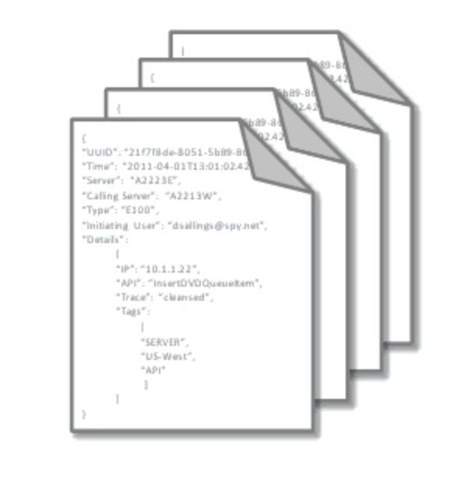
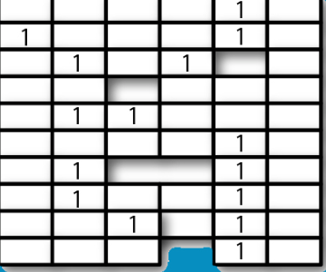

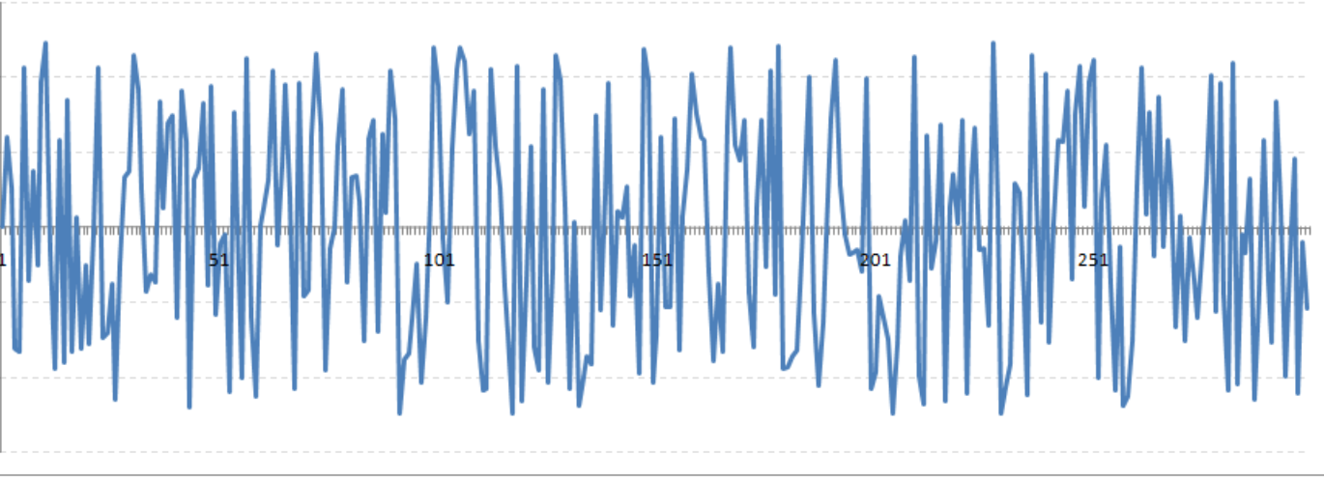
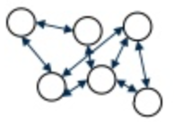

Multi-Model Flexibility
One Multi-model database for many use cases
Common underlying foundation –Scale, HA, Data Consistency, Security, Ease of management
Run Multiple use cases on a single multi-tenant cluster
Open & intuitive interfaces supporting operational & analytics applications
Document
Wide-Column
Key-Value
Custom data models (Graph, Time series)

Slide 27
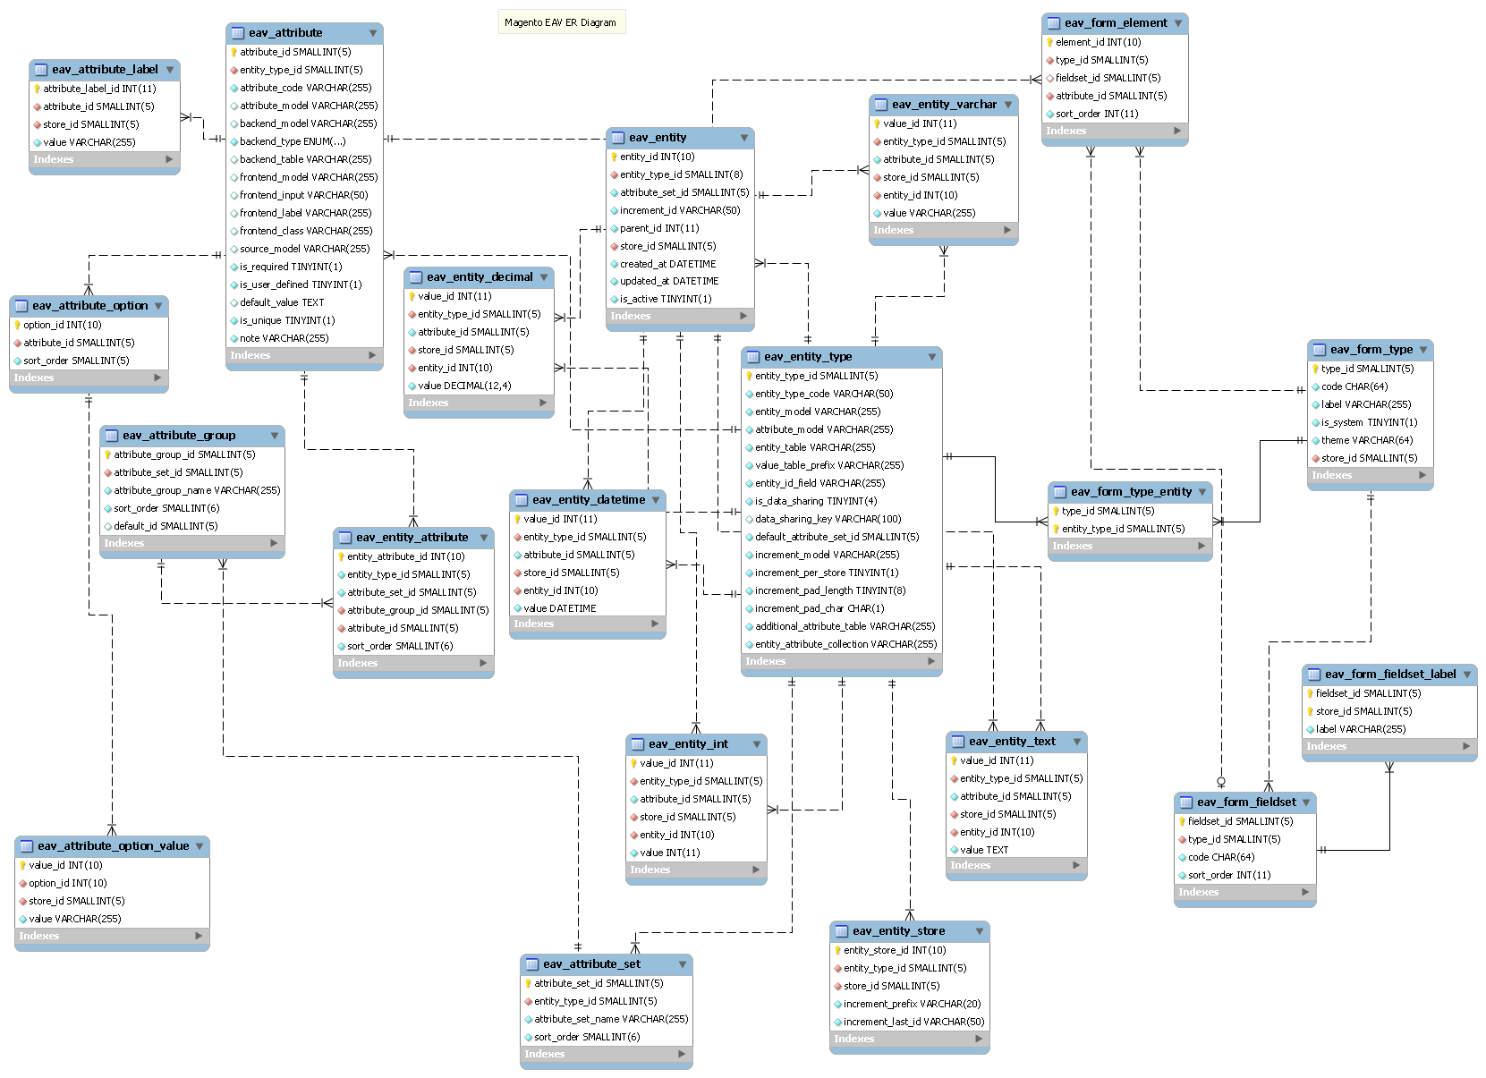
Typical RDBMS Data Model
SELECT * FROM (
SELECT
ce.sku,
ea.attribute_id,
ea.attribute_code,
CASE ea.backend_type
WHEN 'varchar' THEN ce_varchar.value
WHEN 'int' THEN ce_int.value
WHEN 'text' THEN ce_text.value
WHEN 'decimal' THEN ce_decimal.value
WHEN 'datetime' THEN ce_datetime.value
ELSE ea.backend_type
END AS value,
ea.is_required AS required
FROM catalog_product_entity AS ce
LEFT JOIN eav_attribute AS ea
ON ce.entity_type_id = ea.entity_type_id
LEFT JOIN catalog_product_entity_varchar AS ce_varchar
ON ce.entity_id = ce_varchar.entity_id
AND ea.attribute_id = ce_varchar.attribute_id
AND ea.backend_type = 'varchar'
LEFT JOIN catalog_product_entity_text AS ce_text
ON ce.entity_id = ce_text.entity_id
AND ea.attribute_id = ce_text.attribute_id
AND ea.backend_type = 'text'
LEFT JOIN catalog_product_entity_decimal AS ce_decimal
ON ce.entity_id = ce_decimal.entity_id
AND ea.attribute_id = ce_decimal.attribute_id
AND ea.backend_type = 'decimal'
LEFT JOIN catalog_product_entity_datetime AS ce_datetime
ON ce.entity_id = ce_datetime.entity_id
AND ea.attribute_id = ce_datetime.attribute_id
AND ea.backend_type = 'datetime'
WHERE ce.sku = ‘rp-prod132546’
) AS tab
WHERE tab.value != ’’;
To get a single product

Slide 28
Using JSON to store Business Object
{
"name": "BLACKPINK",
"barcode": "4988064584994",
"language": "eng",
"_id": "ea3cb8fd-0c2a-41d5-a3c7-b4c91cf659bf",
"slug": "blackpink-3",
"artists": [{"name": “BLACKPINK", "_id": “4864…23c”, …} ],
"tracks": [
{"name": “BOOMBAYAH", "length": 241000, "position": 1},
{"name": “WHISTLE”, "length": 212000, "position": 2},
{…}
],
"cover_image_url": “http://cov.org/ea38fd-d5-a3/17659010300.jpg",
"images_urls": [],
"released_date": 1503964800000
}
artists.findById(“rp-prod132546”)
Store the artist “as a business object”
To get a single artists
28￼

Slide 29
MapR-DB JSON Implements the OJAI API
Comprehensive Java API to interact with MapR-DB
Support for CRUD operations
Create
Read
Update
Delete
Server-side operations (increased performance)
Data mutations
Projections
Queries

Slide 30
Familiar JSON Paradigm – Similar API Constructs
MapR-DB
MongoDB
Document record = Json.newDocument()
.set("firstName", "John")
.set("lastName", "Doe")
.set("age", 50);
table.insert("jdoe", record);
BasicDBObject doc = new BasicDBObject
("firstName", "John")
.append("lastName", "Doe")
.append("age", 50);
coll.insert(doc);

Slide 31
Secondary Indexes Maximizes Performance
Sample row
{ “Name” : “John”, Age : 10, Address : { “Apt” : 802, Street : “Holger way”, State : CA, Zip : 94086}, Activity: Medium}
Example index
Create index on t fields “Address.State DESC, Age ASC”
covered fields Activity
Table Index table
_id | Age | State | Activity
ROW1 | 10 | CA | Medium
ROW2 | 20 | NJ | Low
ROW3 | 12 | FL | Low
ROW4 | 10 | NJ | High
ROW5 | 20 | CA | High
_id | Activity
20_CA_Row5 | High
20_NJ_Row2 | Low
12_FL_Row3 | Low
10_CA_Row1 | Medium
10_NJ_Row4 | High

Slide 32



MapR-DB Multi-Master Table Replication
Multi-master (active/active) replication
Faster local data access – minimize network latency on global data with local clusters
Reduced risk of data loss – real-time, bi-directional replication for synchronized data across active clusters
Application failover – upon any cluster failure, applications continue via redirection to another cluster
Active Read/Write
End Users

Slide 33
MapR Streams

Slide 34





Qu’est-ce que le streaming ?
Une technologie pour stocker et traiter les évènements de manière continue
Qu’est-ce qu’un évènement ?
Action ou occurrence détectée par un programme
Exemples :
Retail: object vendu, rupture de stock, paiement accepté, rejeté, …
Telco: Call initié, terminé, interompu, ....
IoT: Lecture de temperature, pression, humidité, …
IT: System crash, access non autorisé, login failed, ...

Slide 35




Qu’est-ce qu’un Stream ?
Un Stream est une séquence ininterrompue d’évènements transmise depuis une série de « producers » vers une série de « consumers »
Producers
Consumers
Stream
Producers et Consumers n’ont pas à se connaitre
Les évènements sont groupés sous forme de “topic”
Plusieurs producers et consumers peuvent utiliser le même topic
Cette architecture s’appelle « Publish – Subscribe »

Slide 36

MapR-ES (Event Streaming)
Unique global streaming architecture
Standard Kafka API
Unlimited scalability
Arbitrary topology of thousands of clusters
Point-to-Point, Ring, Star, Mesh, etc.
Global applications & data collection
Producer & consumer failover

Slide 37
MapR-ES Differentiation
Single, shared cluster for files, DB, and streams.
Global built-in replication,
build “fabrics” with failover.
Billions of topics, consumers
Self-Managed
Global IoT Scale
Automatic data balancing “system of record” persistence.
MapR-ES
>2X Performance of Kafka
Secure & Multi-Tenant
Authentication, authorization, encryption. Unified security with all other platform services.
Multi-tenant using “streams”, logical grouping of topics and messages.

Slide 38
Automatic Partition Balancing Allows
“Stream of Record”
Kafka
MapR-ES
Benefits
Better SLAs due to less hotspotting of data.
Lower opex through less node, partition mgmt.
Simpler “stream of record” architecture by allowing MapR-ES to be long-term storage.
Partitions assigned to single disk, can easily outgrow and corrupt.
Assignment doesn’t consider input rate, retention policy.
Partitions tricky to move.
Partitions divided into partitionlets and spread.
Partitionlets assigned based on utilization.
Partitionlets moved on failure, rebalanced periodically.

Slide 39
Reliable Global Replication
Kafka
MapR-ES
Benefits
Producers
Producers & Consumers
Increased application availability due to automatic failover between clusters
Lower opex through increased pipeline reliability
Lower capex due to simpler replication designs - less clusters
Producers & Consumers
Consumers
Bolt-on app (MirrorMaker)
Message offsets differ in each cluster
Complex 2-stage cluster diagram to avoid loops
Integrated replication in core platform
Offset/metadata synchronized globally
Built-in loop prevention

Slide 40
Secure, Efficient Multi-tenancy
Kafka
MapR-ES
Benefits
Clicks
Impressions
Transactions
Transactions2
Lower capex through single cluster serving all groups, applications.
Lower opex through simpler administration of topics, security.
Clicks
Impressions
Transactions
Clicks
Impressions
Transactions
Single topic namespace per Kafka cluster results in collisions.
Lack of placement policy results in extra clusters.
Security at topic level complex at scale.
Billions of namespaces possible, called “streams”
Stream-level security easier manageability
Data placement policies to meet SLAs without extra clusters

Slide 41
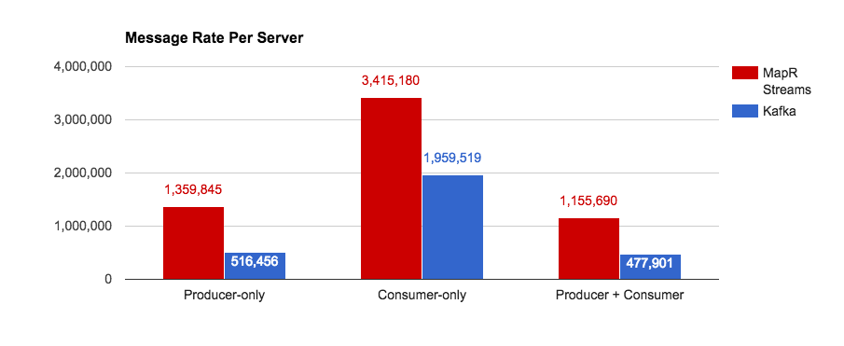
>2X Performance Advantage
+74%
+163%
+141%
Higher Performance → Less Nodes → Lower TCO

Slide 42
Sécurité

Slide 43

Platform-wide Consistent Security Model
Ubiquitous Data Protection
Flexible Authentication
Encryption for Data in Motion
Within a Cluster
Between Clusters
Between Client and Cluster
Encryption for Data at Rest
Built-in
LUKS
Self-Encrypting Disk
Partners
Wire-level authentication for all services in the cluster
NSA-level cryptographic algorithms
Integration with LDAP, Active Directory and other third party directory services
Kerberos or username/password authentication
DP
A
DP
A
A
A
A
A
Robust Auditing
Granular Authorization
All events recorded immediately in JSON log files and into pub/sub
Includes data access and admin actions
Ad-hoc queries and custom reports on audit logs via SQL and standard BI tools
Access Control Expressions
Protect files, tables, column families, columns, messages and management objects
Extend to role-based access control (RBAC) with custom role functions
Views for row level/cell level authorization

Slide 44
Flexible Authentication with MapR

Slide 45

MapR Authentication
AUTHENTICATION
A. Request/get MapR ticket
MapR Client (MapR username/password authentication)
Cluster
MapR Options:
Kerberos integration – plug into existing Kerberos infrastructure (some limitations apply)
MapR username/password – same model, much easier to set up
Trivially configure during cluster install
Verify passwords using Linux PAM (supports every registry)
C. Authenticate with ticket
MapR Client (Kerberos)
B. Get MapR ticket
C. Authenticate with ticket
A. Request/get Kerberos ticket
B. Check username, password
Existing security infrastructure
Kerberos KDC
User Directory (AD, LDAP, NIS, …)

Slide 46
Granular Authorization with MapR

Slide 47
The Problem with POSIX Permissions
AUTHORIZATION
POSIX Permissions
-rw-rw---- bruce dev-team
user
group
other
Scenario 1:
Sally needs to read the file.
Options:
Scenario 2:
Groups ‘QA’ and ‘Support’ need to read the file.
Options:
Scenario 3:
All members that belong to both dev_team and managers.
Change ownership of file to Sally.
Add Sally to dev-team group, even if she’s not a developer.
Allow ‘others’ to read the file.
Allow ‘others’ to read the file.
Create a supergroup ‘Tech’, and include all members from dev, QA, and Support in that group. chgrp Tech <filename>
???
POSIX Permissions Are Limiting

Slide 48
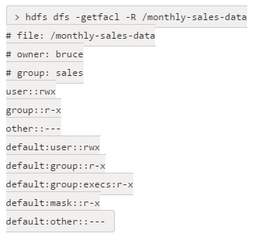
POSIX ACLs versus MapR ACEs
AUTHORIZATION
r : user:sally |
(group:dev_team & group:managers)
Access Control Expressions
(A MapR Innovation)
Access Control Lists
(Other platforms)
Which one is easier to set and understand?
Which one allows for higher granularity?

Slide 49




File Access Control Expressions – Key Features
AUTHORIZATION
Boolean Operators
Allowing for ultra fine-grain
permissions
Intuitive Inheritance
Subdirectories and files inherit perms from parent directory
High Performance
No performance hit
Roles
Arbitrary grouping of users according to your business needs
Whole-Volume ACEs
Volume-level filter – useful in multitenant environments.

Slide 50
Data Protection with MapR

Slide 51
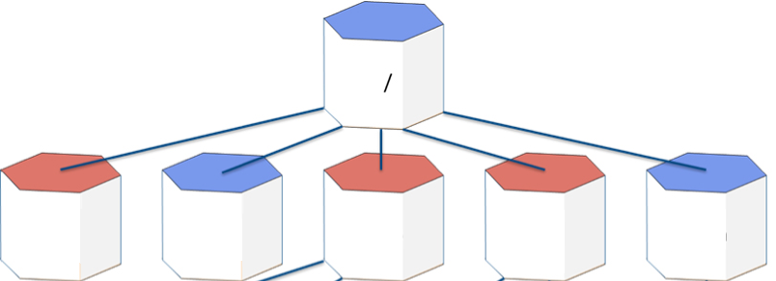

Native Data at Rest Encryption
KEY BENEFITS
Reduce risks and maintain compliance
Simplify security setup
WHAT IS UNIQUE
Enabled during volume create (when secure-by-default is on)
Volume-level encryption
FEATURES
Encrypts all files, directories, tables, streams, even metadata
Data is encrypted using AES 256 (XTS mode)
Completely transparent to application
/hr
/hbase
/pci
/users
/var/mapr
Encrypt Data Per Volume or Per Cluster Level

Slide 52
Encryption – On the Wire
Three variants depending on component
MapR native security/maprsasl
AES 256 GCM Mode (NIST approved)
Used by MapR platform for file, table, and stream traffic as well as YARN communication and a few ecosystem components
HTTPS/TLS
TLS 1.2 enforced
Used by Web interfaces as well as some ecosystem components
Kerberos
Used by some Apache ecosystem components for communication

